Slide 1
Robot tactile sensing

Slide 2
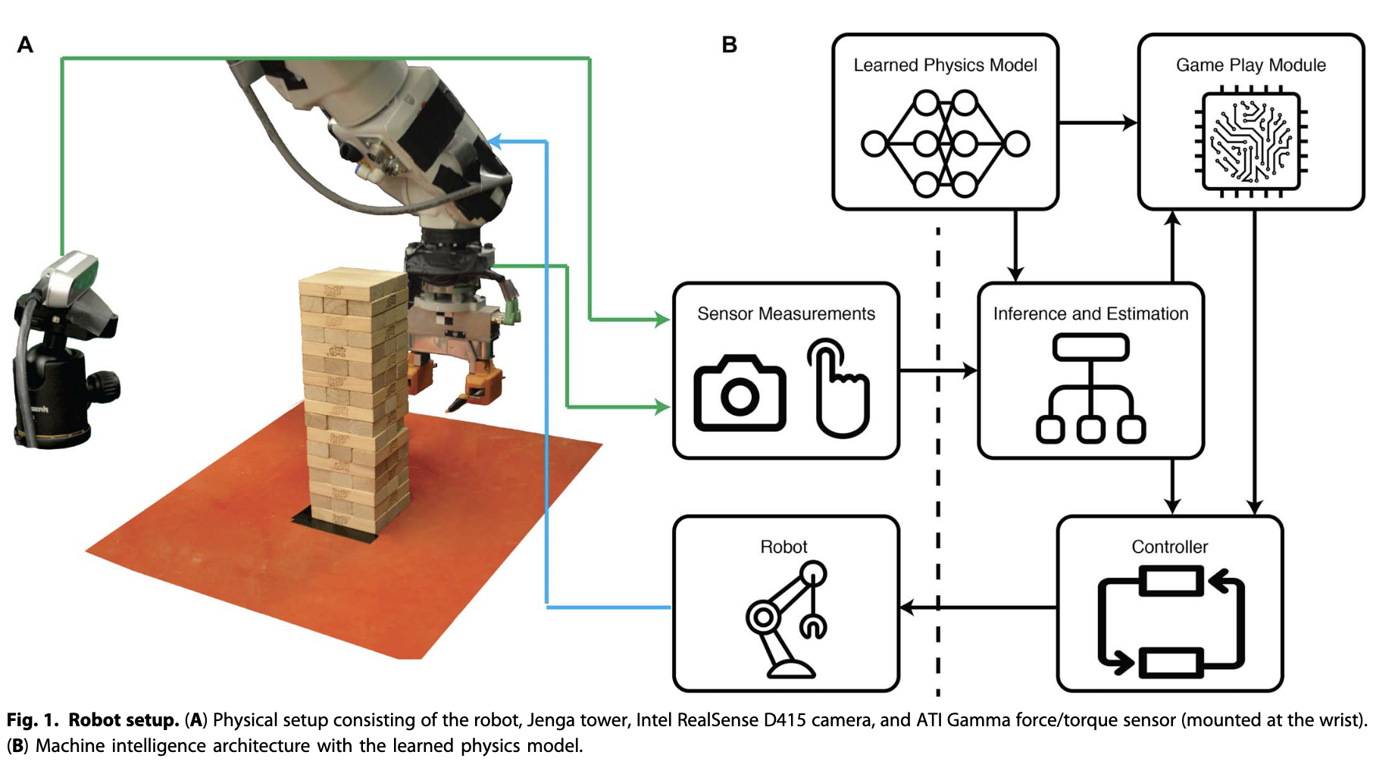
See, feel, act: Hierarchical learning for complex manipulation skills with multisensory fusion
A hierarchical learning framework that integrates tactile and visual feedback
Combines top‐down high-level concept learning with bottom‐up construction of detailed motion models using probabilistic inference, Bayesian neural networks, and MPC.
Compared to feed-forward networks, regression mixtures, and reinforcement learning
Notes:
Combines top‐down high-level concept learning (e.g., “no move,” “easy move,” “hard move”) with bottom‐up construction of detailed motion models using probabilistic inference, Bayesian neural networks, and MPC.
Compared to feed-forward networks, regression mixtures, and reinforcement learning

Slide 3
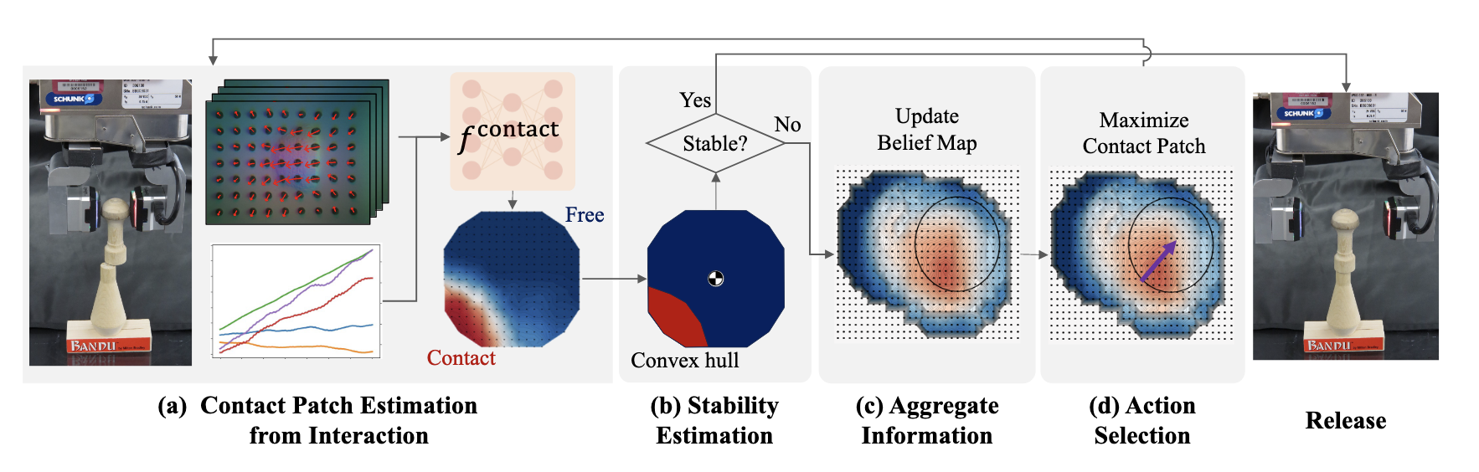
Tactile Estimation of Extrinsic Contact Patch for Stable Placement
Using tactile and force-torque (F/T) sensor data to predict the contact surface
Stability is assessed by constructing a convex hull from the predicted contact patch
Collecting training data by having the robot probe a 3D-printed board with known shapes.

Slide 4
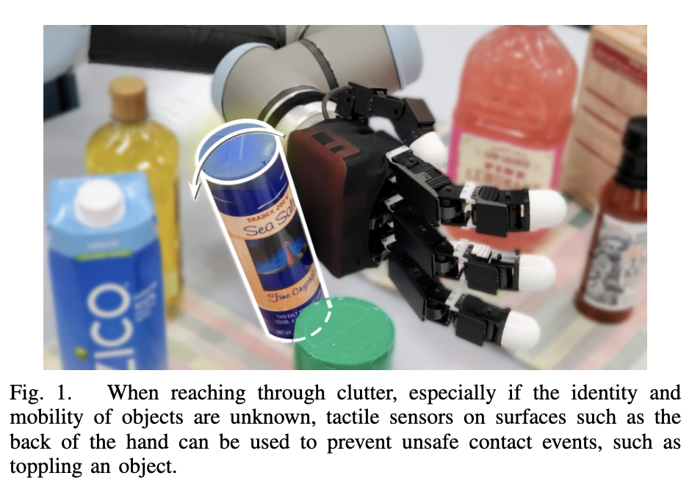
Going In Blind: Object Motion Classification using Distributed Tactile Sensing for Safe Reaching in Clutter
A tactile-based approach to classify object motion during incidental contacts
A novel distributed tactile sensor network is deployed on the back of the Allegro Hand
The experiments show high classification accuracy (above 90% in many cases)
Notes:
The approach may struggle with objects that do not adhere to the rigid and convex assumptions (e.g., deformable or granular objects like coffee beans or irregular containers).
• The method relies on controlled experimental conditions and manual labeling for ground truth, which may limit its generalizability to more dynamic or unstructured real-world environments.
• Some failure cases were observed, particularly when the tactile signal ambiguities arose from non-standard contact geometries or complex object motions, indicating a need for further refinement or integration with additional sensing modalities.

Slide 5
Estimating An Object’s Inertial Parameters By Robotic Pushing: A Data-Driven Approach
Estimates mass, 2D CoM, and rotational inertia from a single quasi-static push using features derived from force, moment, and velocity.
Combines analytical pushing mechanics with a Multi-Output Regression Random Forest for robust prediction across varied friction and object properties.
Validated on both simulated and real datasets with low error; however, it’s restricted to 2D parameters under quasi-static conditions and faces sim-to-real transfer challenges.

Slide 6
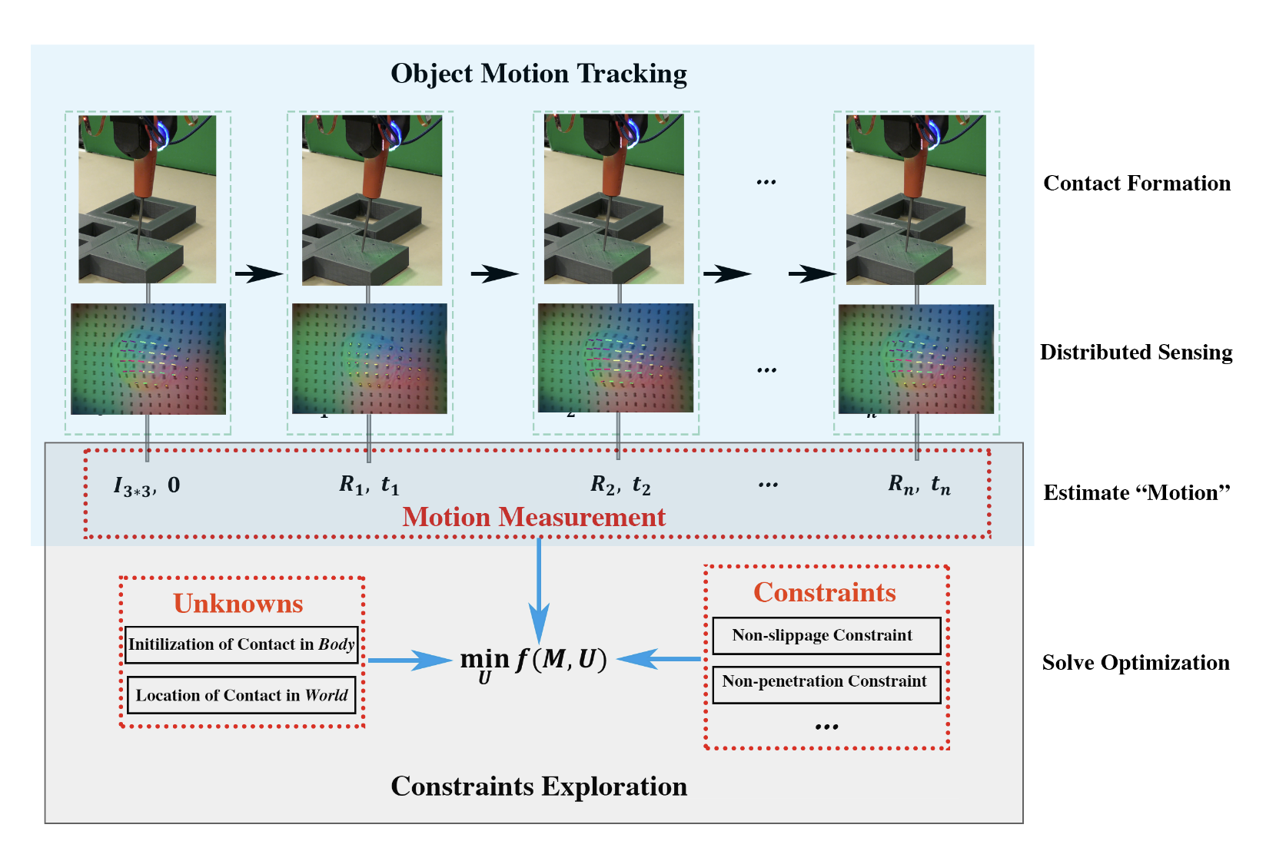
Extrinsic Contact Sensing with Relative-Motion Tracking from Distributed Tactile Measurements
Uses tactile sensor data to solve a constraint optimization problem for localizing extrinsic contacts from the object’s small relative motions.
Leverages sensors like GelSlim 3.0 to recover detailed 3D motion fields of tactile markers without prior object geometry.
Enables contact sensing for insertion/assembly tasks

Slide 7
The limitation of current research
Data Limitation: Real-world tactile data is difficult to collect due to extensive setup requirements, and simulating complex physical interactions remains challenging.
Lack of End-to-End Models: Because of limited data, current approaches often rely on handcrafted policies and geometric computations rather than fully integrated end-to-end learning models.
Lack of Universal Evaluation: There is no widely accepted benchmark or standardized metrics for evaluating tactile sensing and manipulation tasks.
Sensor Limitations: Existing tactile sensors still struggle to capture fine-grained tactile features, limiting the resolution and fidelity of the data.

Slide 8
Opportunities for future research
Sim-to-real transfer from tactile perception
End-to-End grasping pipeline
Multi-modal information fusion

